Slide 1

SOLELY FOR PURPOSES OF FORAGE WORK EXPERIENCE
MODEL RESULT OF PREDICTING CUSTOMER BUYING BEHAVIOR
by
Tessa Agitha
31 January 2024

Slide 2
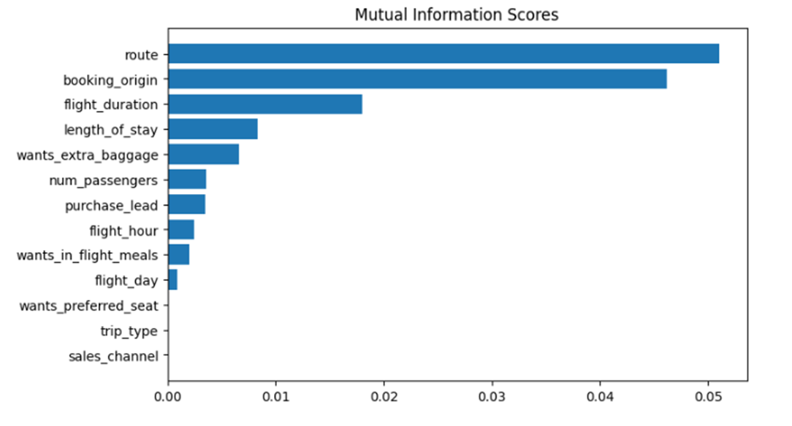
SOLELY FOR PURPOSES OF FORAGE WORK EXPERIENCE
Developing a predictive model to gain insights into the factors that impact consumer purchasing decisions
We have trained the data set with Random forest and XGB classifier model, and received :
Random Forest
XGB
ACCURACY = 84.96
AUC = 0.53
ACCURACY = 84.72
AUC = 0.54
The Top 5 Features that affect customer purchasing decisions are as follows.
Route
Booking origin
Flight duration
Wants_extra_baggage
Length_of_stay

